Slide 1




CAPSTONE1
School Connect Application
Group: C1SE.44 12-2021

Slide 2
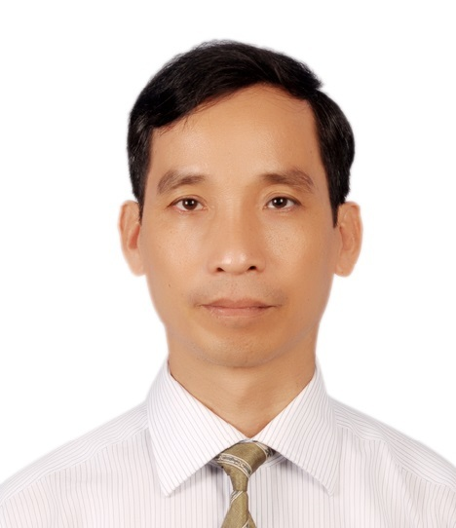

Mr. Nguyen Minh Nhat Email: nhatnm2010@gmail.com
CAPSTONE1
Introduction to Mentor

Slide 3
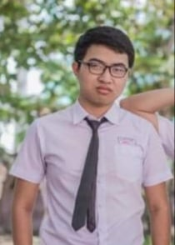

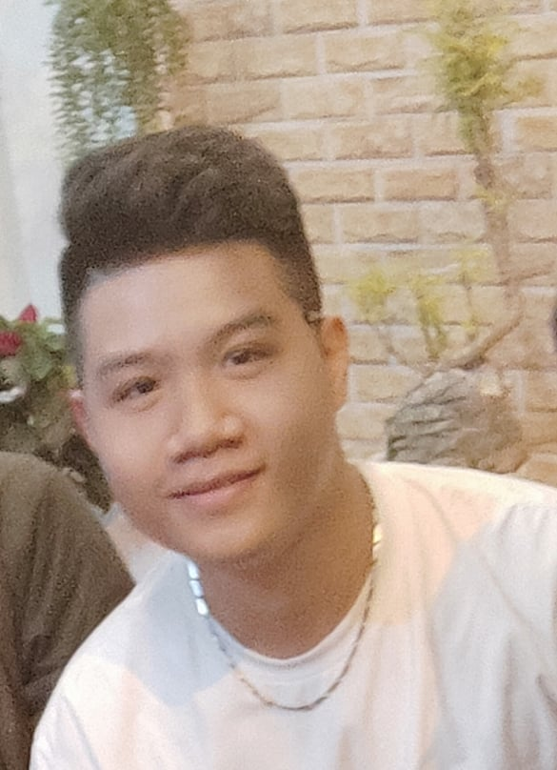


NGUYEN THANH PHU Scrum Master
NGUYEN TRUNG HIEU Product owner, Dev Team
DANG NGUYEN BAO HOAI Product owner, Dev Team
CAPSTONE1
Members of team
Major: Management Information System

Slide 4
CAPSTONE1
Table of contents
INTRODUCTIONS
SOLUTION
OVERVIEW PROJECT
REFLECTION
PROCESS PROJECT
DEMO

Slide 5
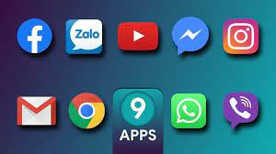
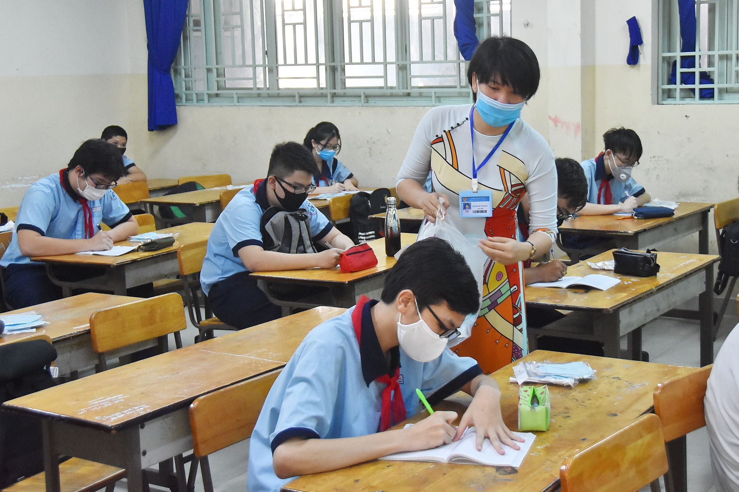
CAPSTONE1
INTRODUCTIONS
In the context of the complicated COVID-19 pandemic, communication and information exchange between students and schools is very difficult.
There are many social networking applications for people to exchange information, but it is easy to leak information and manage students and announcements with many difficulties.

Slide 6

CAPSTONE1
BUSSINESS NEED
- Private and security from the outside.
- Notification about events or policies for students and teachers.
- Easy students and teachers can contact together.
- Manager in information student and teacher
- Manager all forums in the system
- Control posting, commenting, and chat.
Students and teachers can report a comment or messages toxic

Slide 7

CAPSTONE1
SOLUTION
- Provide a web-based School Connect Application for the whole school that allows students and teachers in that school to chat with each other
- Can post articles or events, topics about the school, is a place to exchange and answer questions between students who have been and are studying at the school.

Slide 8
Admin
Censor
Teacher, Student
CAPSTONE1
User management and control of all website content
Control posts and members and delete malicious posts and comments
Role in System
See and interact with people about school issues, join forums that interest them

Slide 9

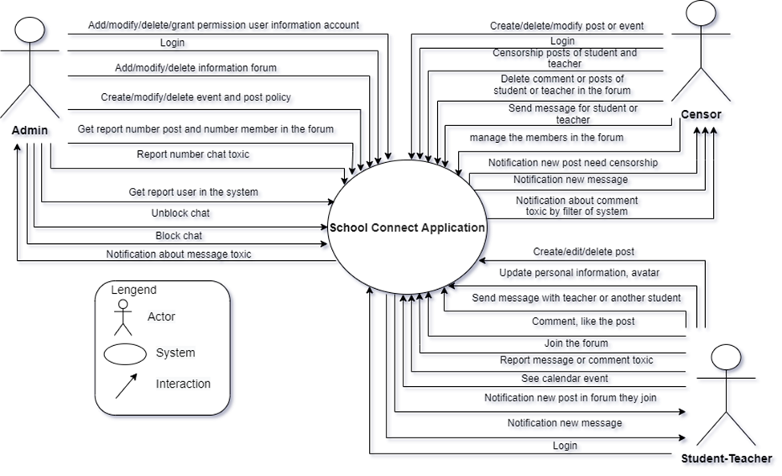
CAPSTONE1
System Context Diagram

Slide 10
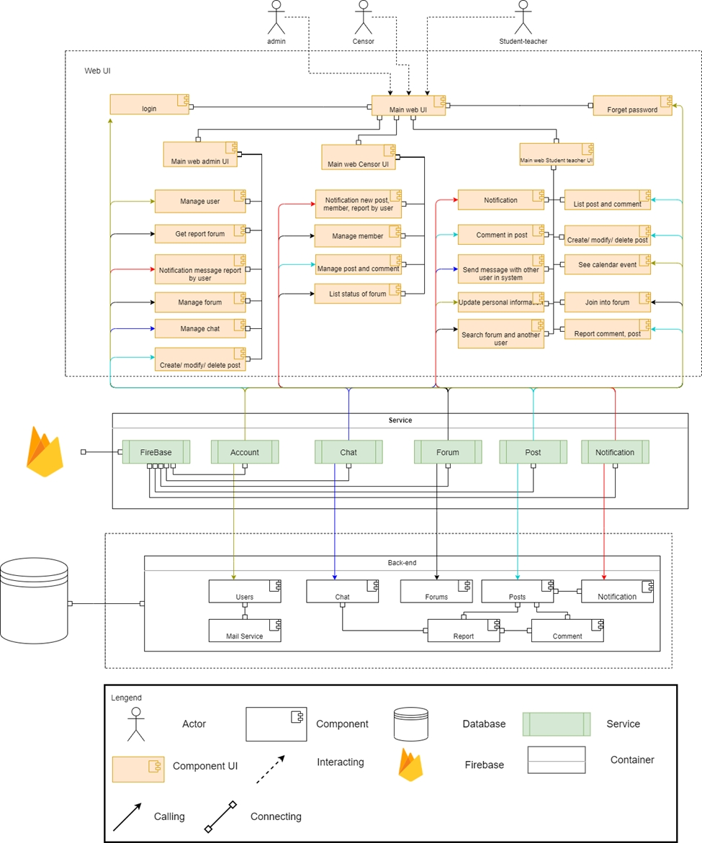
Component & connection
CAPSTONE1

Slide 11
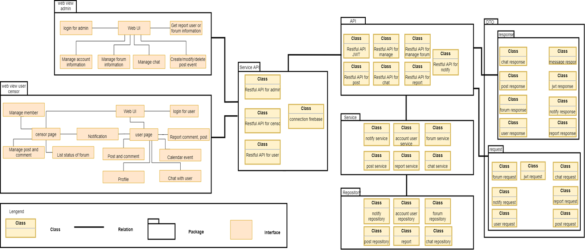
Module view
CAPSTONE1

Slide 12
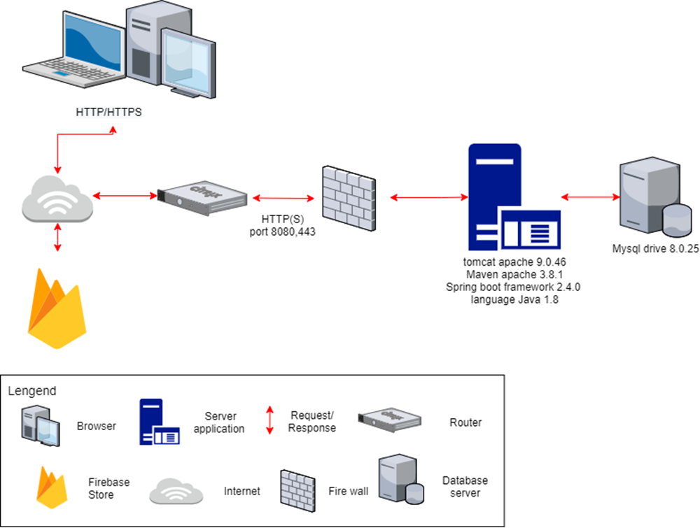
CAPSTONE1
Allocation view

Slide 13
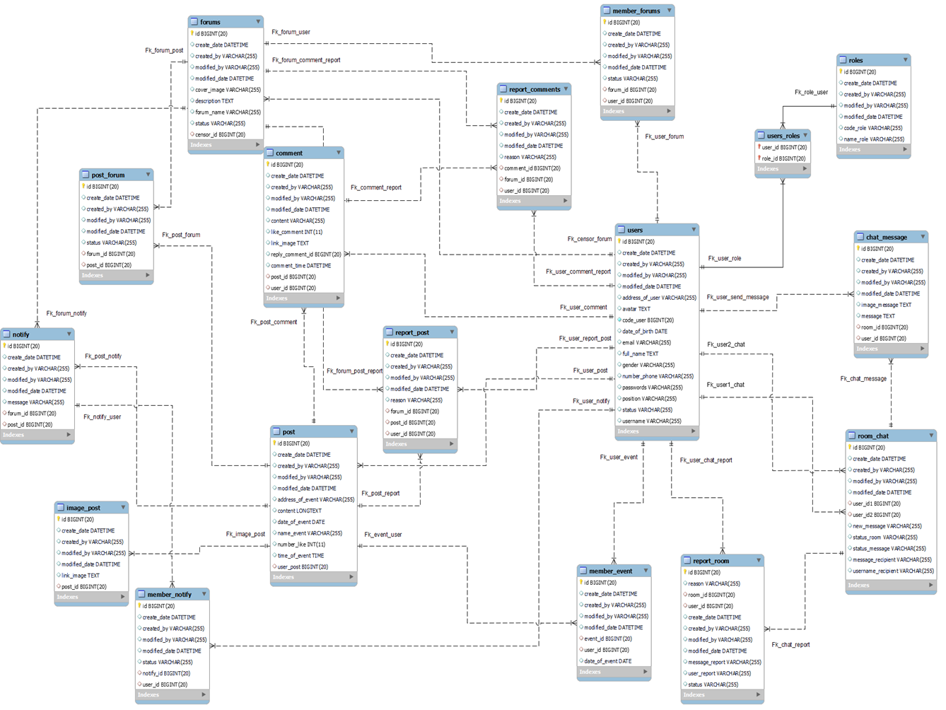
CAPSTONE1
Relationship Database

Slide 14
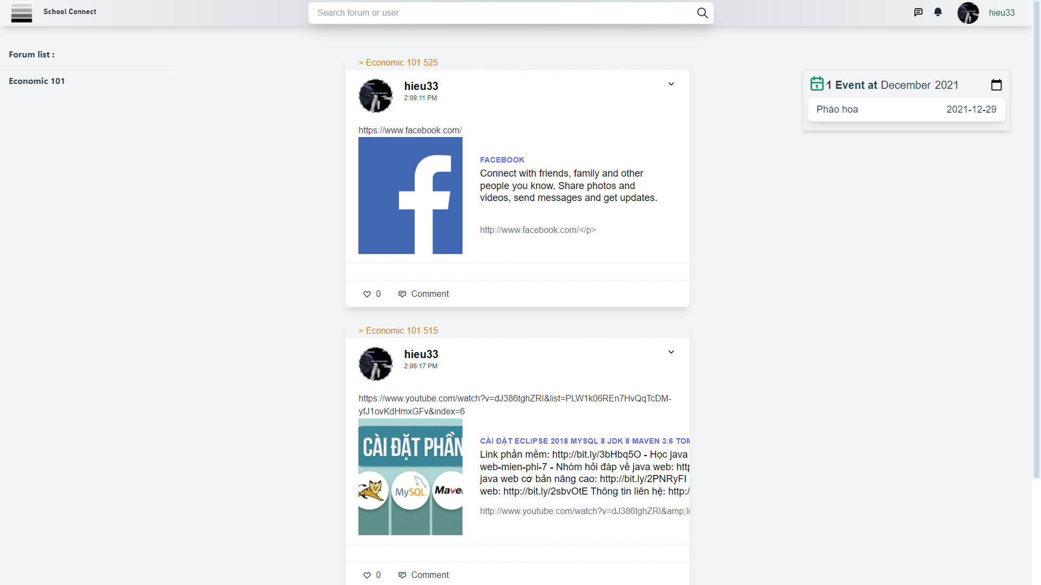
UI for Homepage User
CAPSTONE1

Slide 15
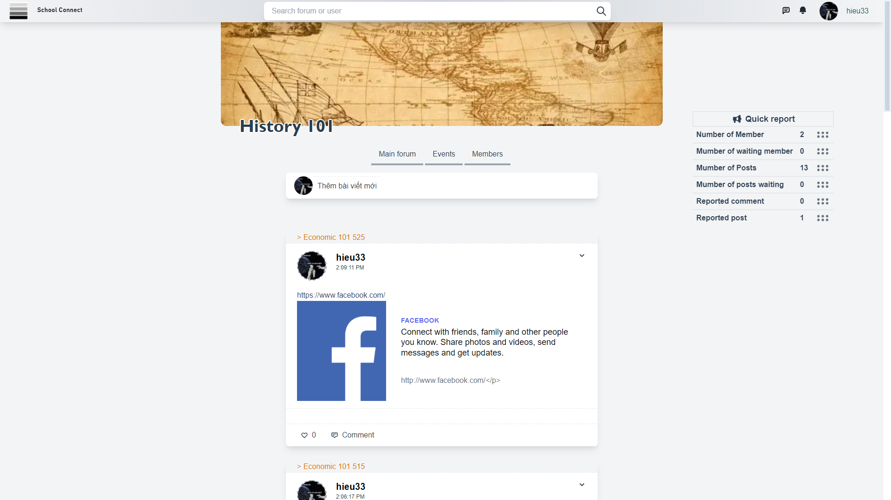
UI for Forum User
CAPSTONE1

Slide 16
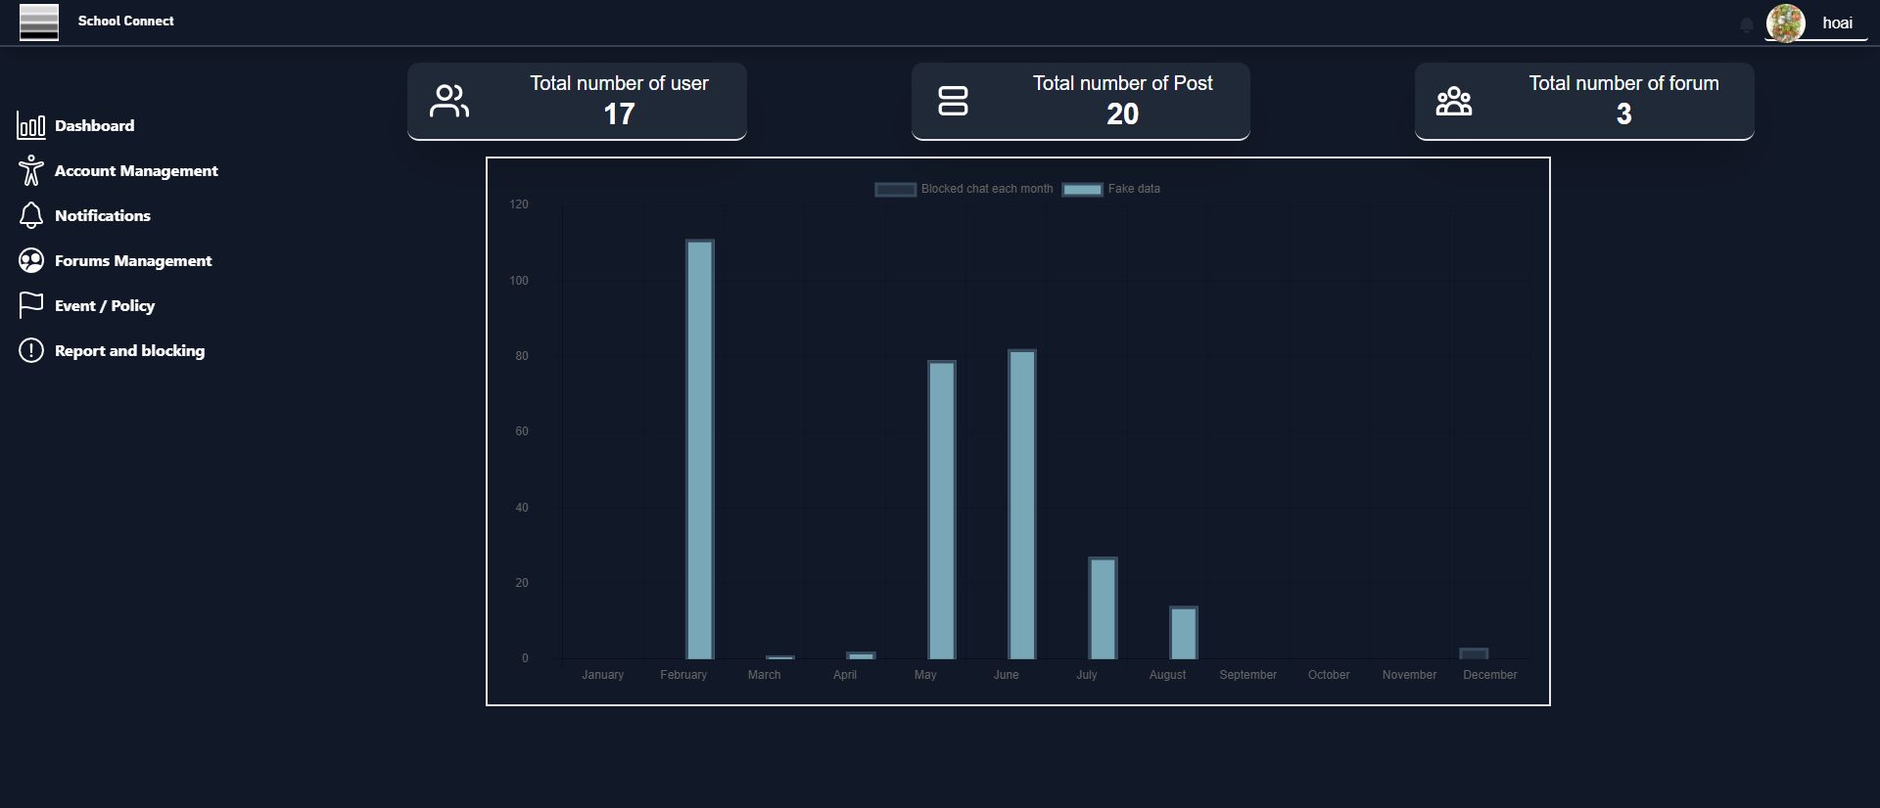
UI for Forum Management Admin
CAPSTONE1

Slide 17
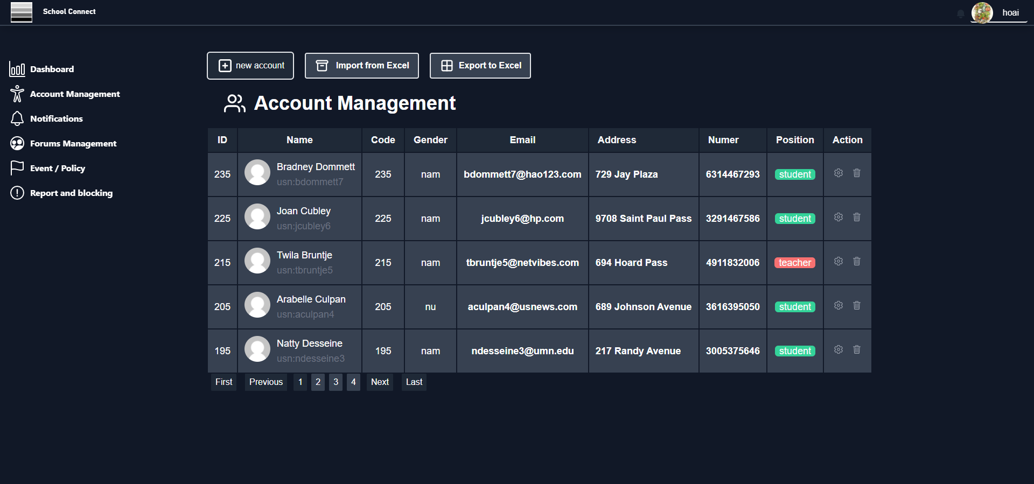
UI for Account Management Admin
CAPSTONE1

Slide 18








SPRING BOOT
FIREBASE
VUEJS
MY SQL
CAPSTONE1
Develop IDE Tools
VISUAL STUDIO CODE
FIGMA
IntelliJ IDEA
POSTMAN

Slide 19




Management tools
Jira for management work
CAPSTONE1
Slack for exchanging information about work
Google meet for management meeting
Github for management source code

Slide 20
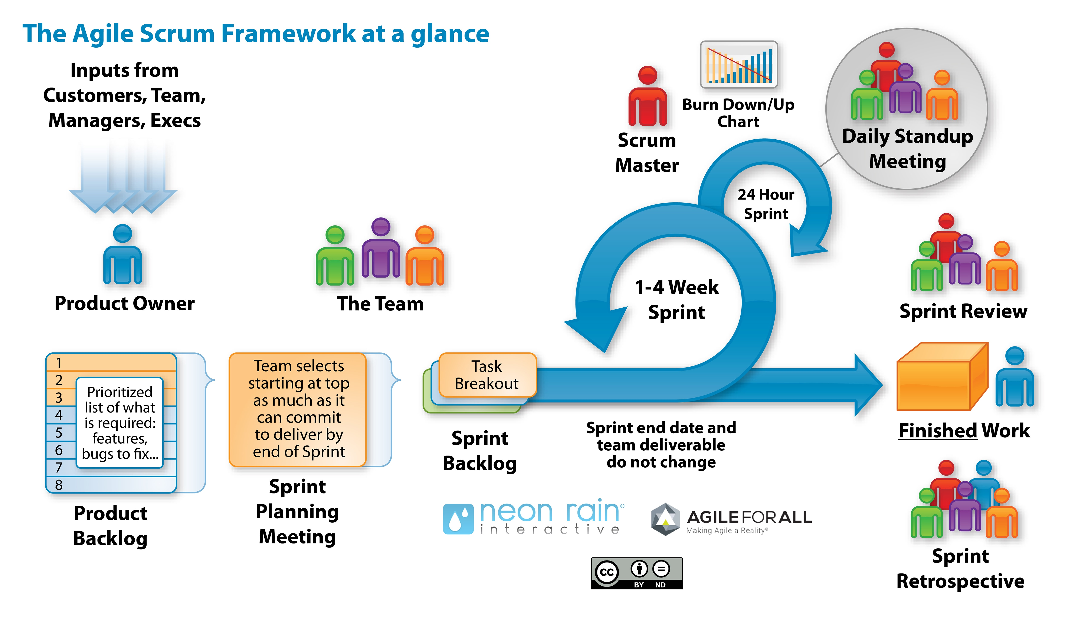
Process Model: Scrum Process
Process model
CAPSTONE1
Scrum is an iterative and incremental agile software development framework for managing software projects and product or application development.

Slide 21
PROJECT PROCESS
CAPSTONE1
ONE
TWO
THREE
FOUR
SPRINT 1
SPRINT 2
SPRINT 3
SPRINT 4
Start day: 06/09/2021 End day: 03/10/2021
During: 28days
Start day: 04/10/2021 End day: 31/10/2021 During: 28days
Start day: 01/11/2021
End day: 21/11/2021
During: 21days
Start day: 21/11/2021
End day: 12/12/2021
During: 21days

Slide 22
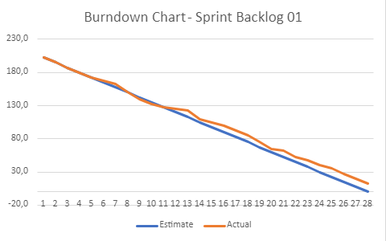
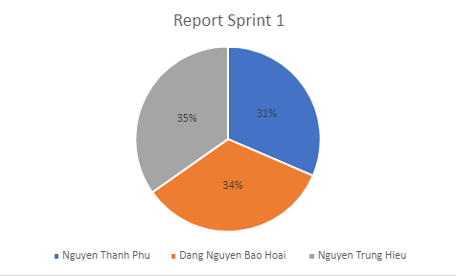
Sprint 1: Burndown Chart
CAPSTONE1
Chart dividing the actual working time of each member
Burndown Chart Sprint 1

Slide 23
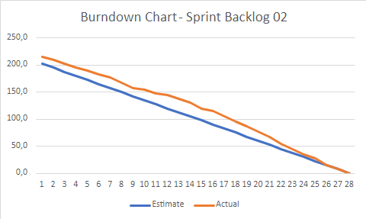
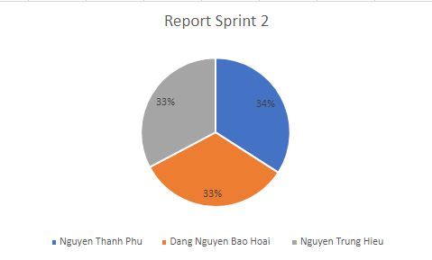
Sprint 2: Burndown Chart
CAPSTONE1
Chart dividing the actual working time of each member
Burndown Chart Sprint 2

Slide 24
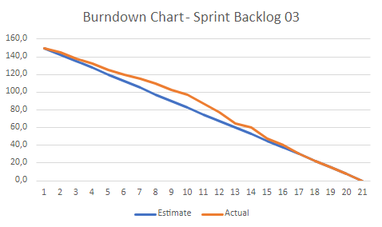

Sprint 3: Burndown Chart
CAPSTONE1
Chart dividing the actual working time of each member
Burndown Chart Sprint 3

Slide 25
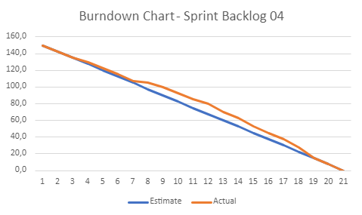

Sprint 4: Burndown Chart
CAPSTONE1
Chart dividing the actual working time of each member
Burndown Chart Sprint 4

Slide 26
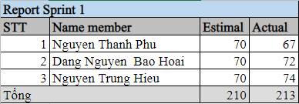

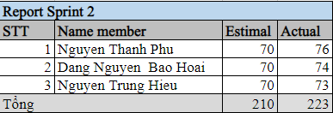
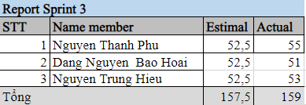
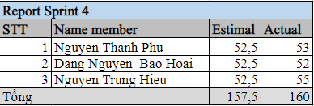
CAPSTONE1
SPRINT REPORT

Slide 27




REFLECTION
DIFFICULT:
LEARNING:
CAPSTONE1
- Lack of experience in project schedule management
- Not much experience with new technology
NOT GOOD:
- Manage time for the work of each task
- Learn new technology while working to apply to the project
- New technology, teamwork
- Scientific workflow management
- Gained a lot of experience in project management and product making
- Learn and understand how to develop projects according to the process

Slide 28
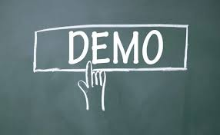
CAPSTONE1
PRODUCT DEMO

Slide 29


Does anyone have any questions?

